Slide 1
C++ No-SQL Database Web Framework
for Cloud-based Websites

Slide 2
Outline
What is a web framework
Prerequisites
Web frameworks
Types of websites
Architecture
Sample application
Code walkthrough
Summary

Slide 3
Prerequisites
C++: classes, templates, STL
Javascript: classes, jQuery
Networks: HTTP, sockets, REST, get, post
Databases: key-index DBs, DB APIs
Linux: command line, bash, g++, cmake
Data access : DTO, DAO, JSON, serialization/deserialization
Docker: containers, dockerfiles
Cloud servers: Google cloud, AWS

Slide 4
What is a Web Framework
Supports dynamic websites
Increases developer productivity
Provide built-in code to handle tasks
Shortens time to create a web application
Enforces specific coding patterns
Simplifies network and database access
Allows consistency and understandability
Increases maintainability

Slide 5
Other C++ Web Frameworks
Other web frameworks
Oat++ (oatpp.io)
Drogon (drogon.org)
POCO (pocoproject.org)
TreeFrog (www.treefrogframework.org)
Pistache (pistache.io)
Why use this framework
Is simpler
Good starter or learner web framework

Slide 6
Why use this framework
Written in C++ and uses a No-SQL database
Faster than interpreted languages or RDMS
Increases user responsiveness
Reduces cloud server CPU and storage costs
Simpler to program
Fewer components for developers to manage
More convenient system administration
Easier to deploy to the cloud

Slide 7
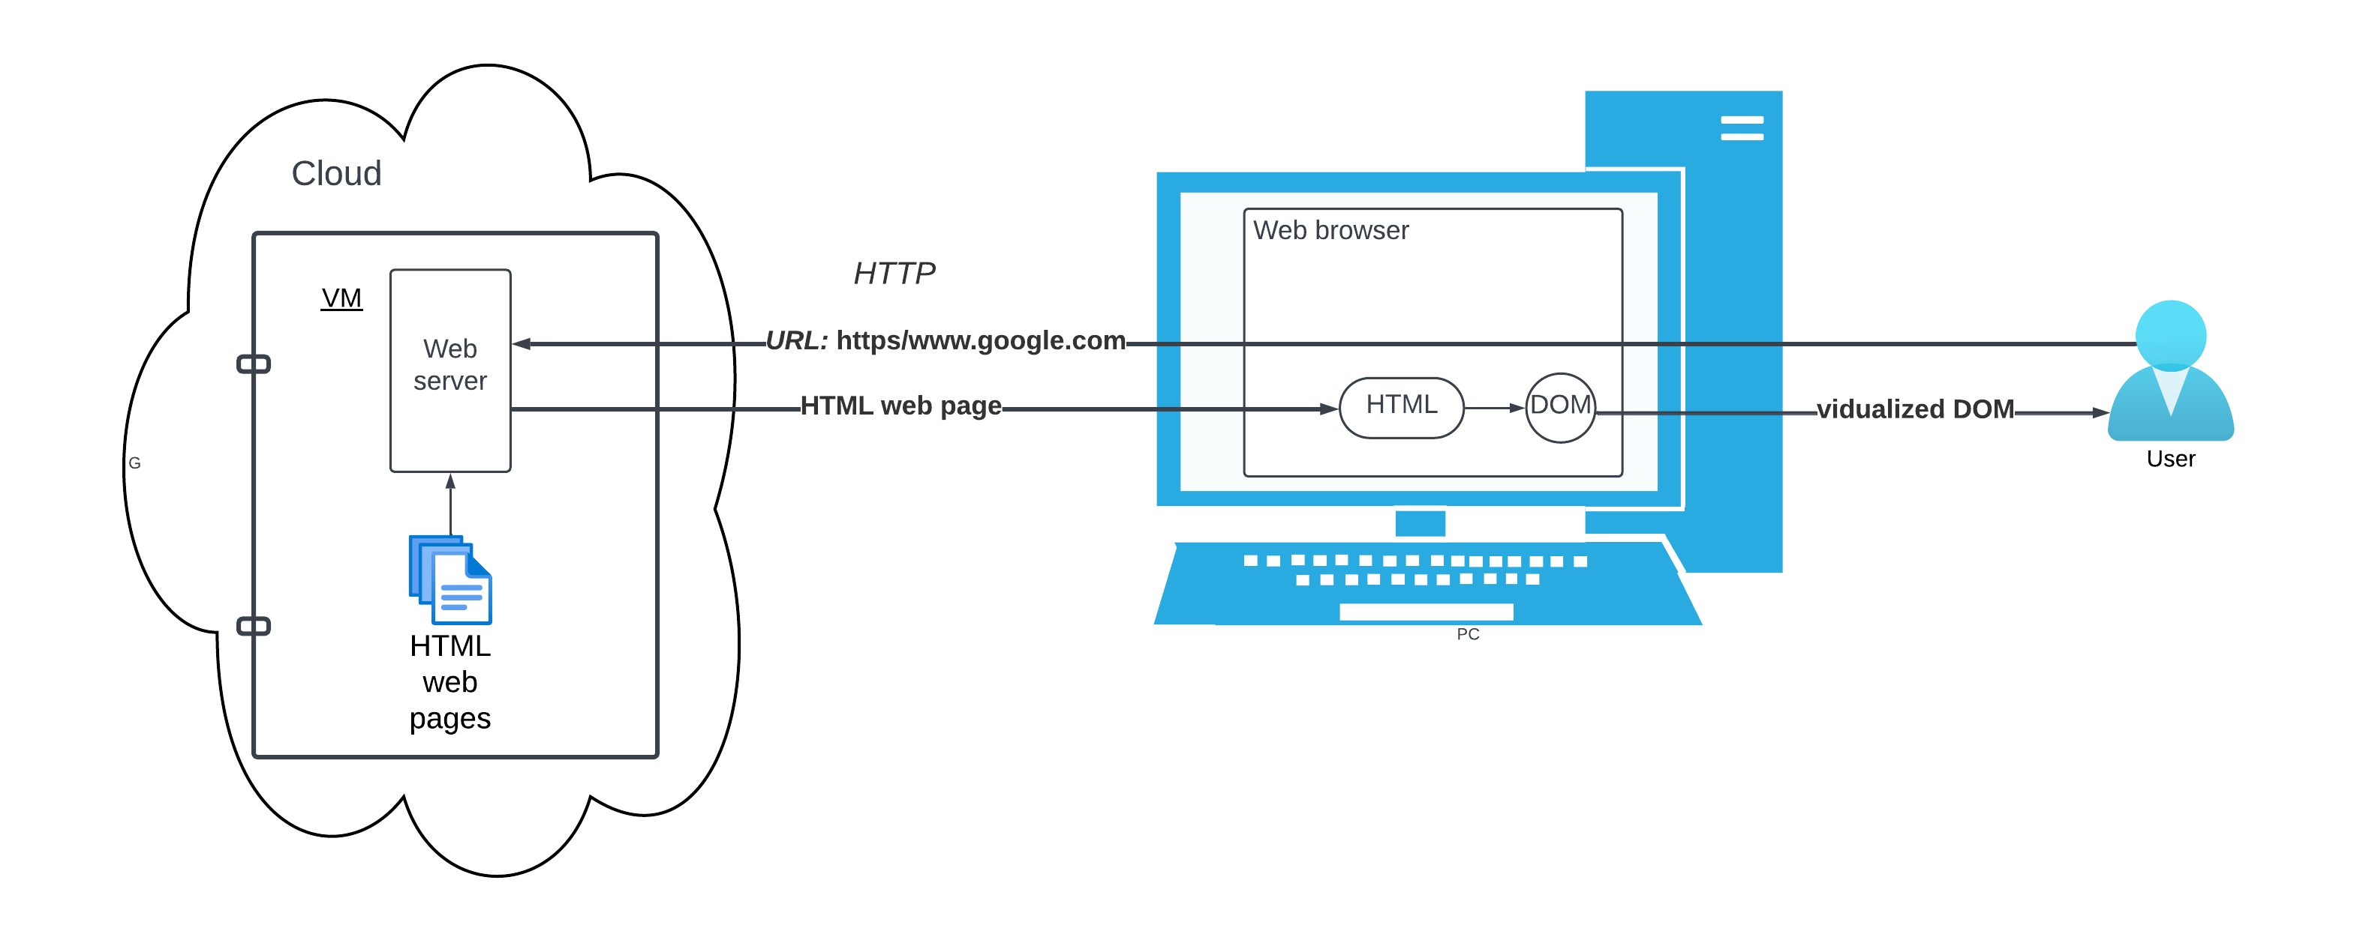
Static websites

Slide 8
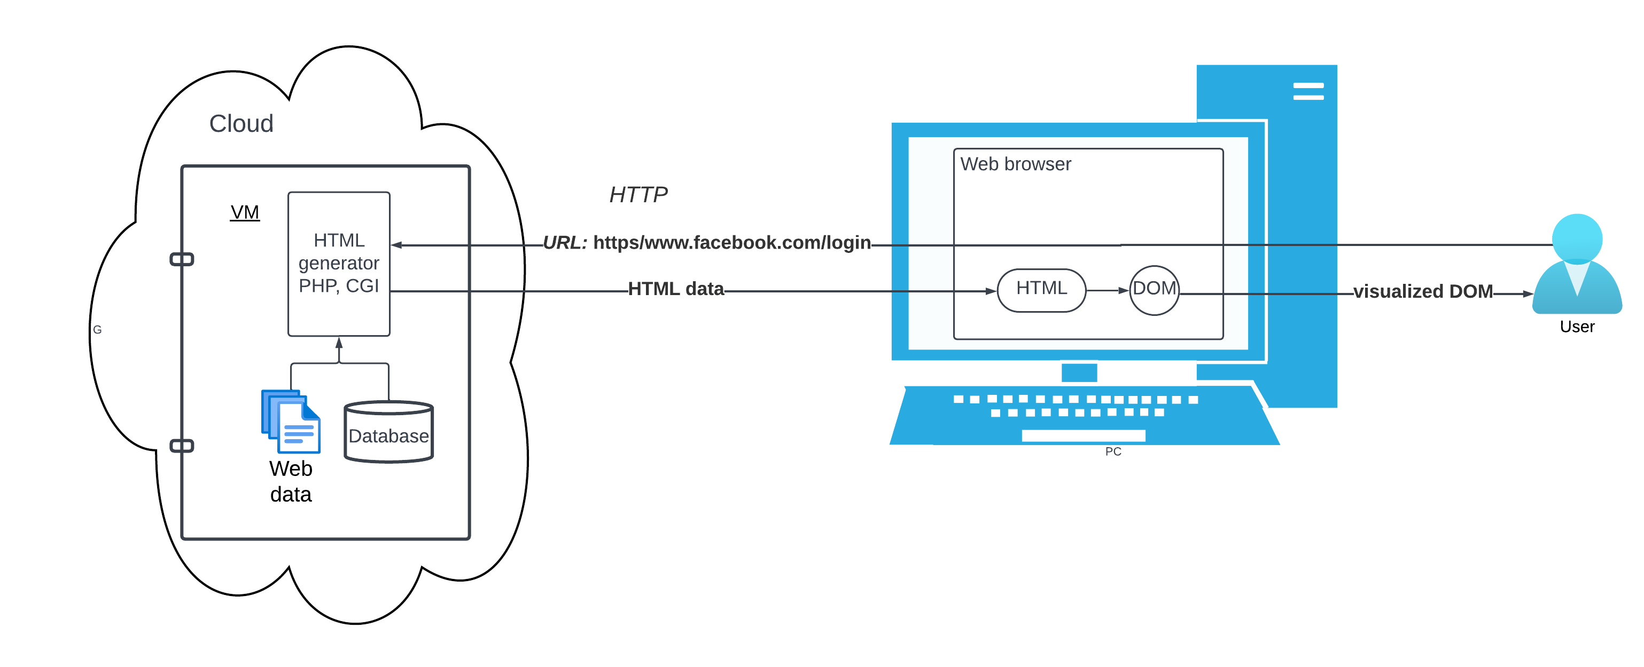
HTML Generators

Slide 9
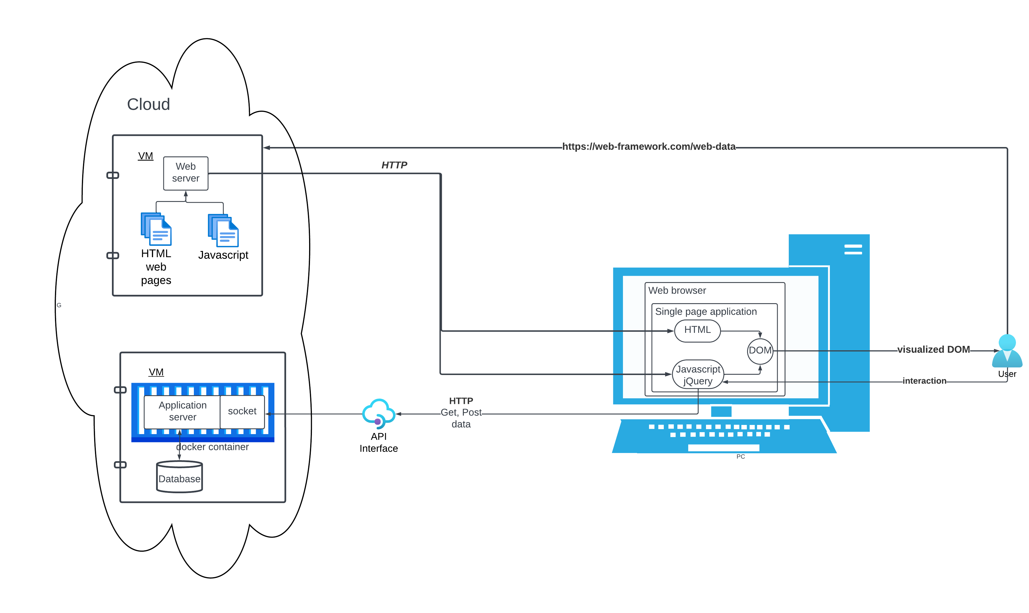
Dynamic websites

Slide 10
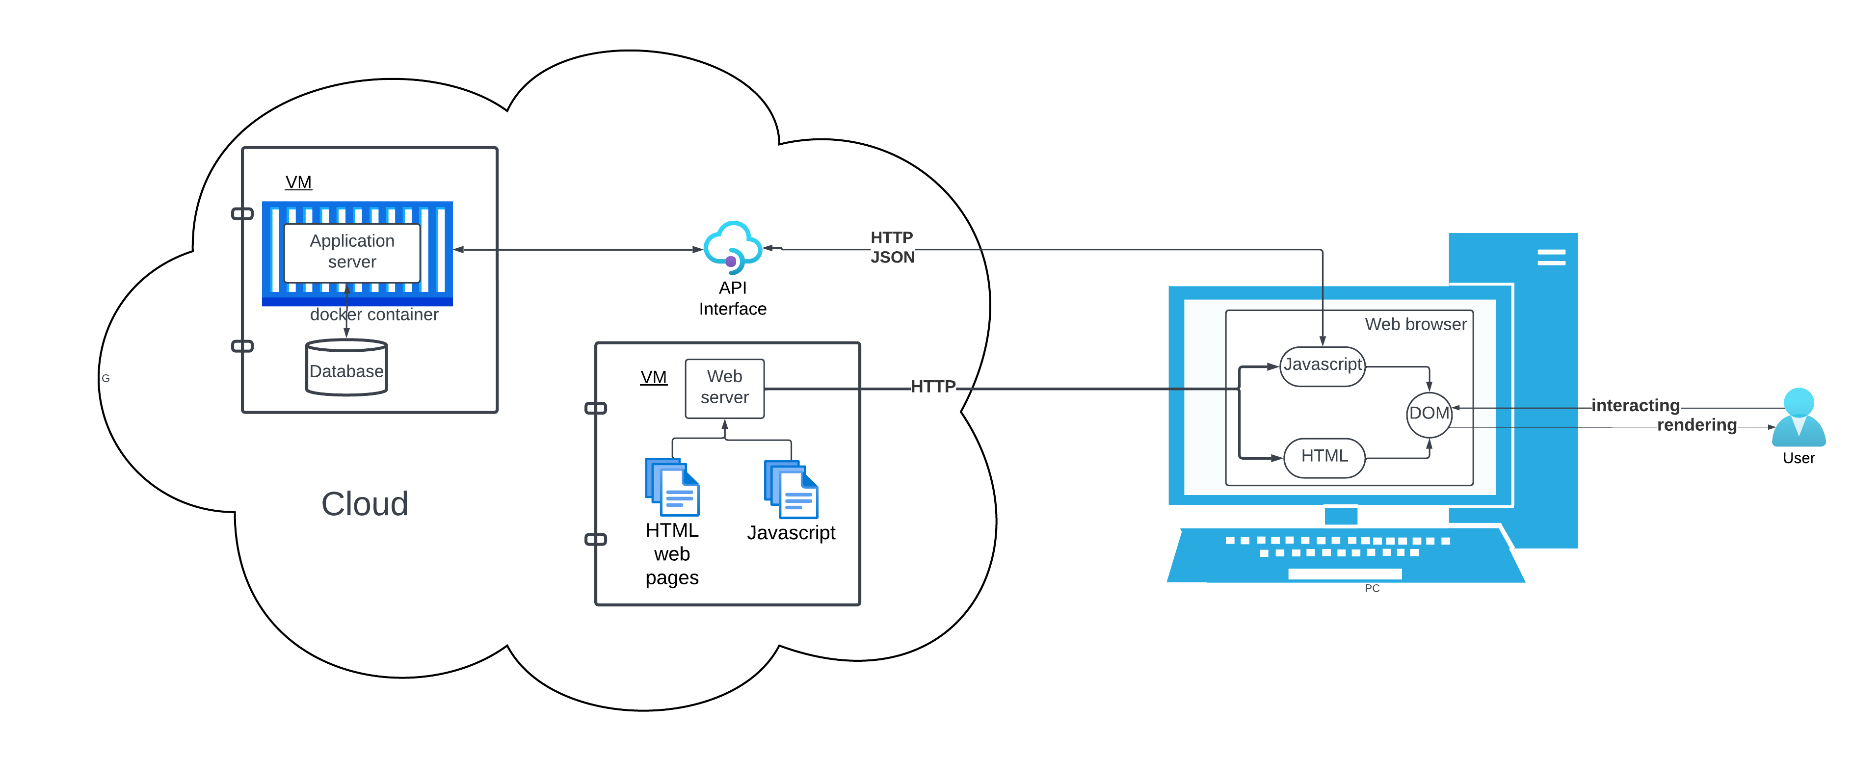
Web Application Deployment

Slide 11
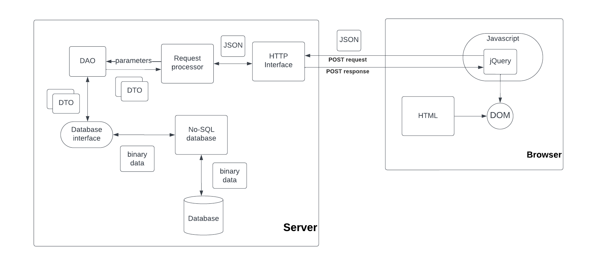
C++ Web Framework Architecture

Slide 12
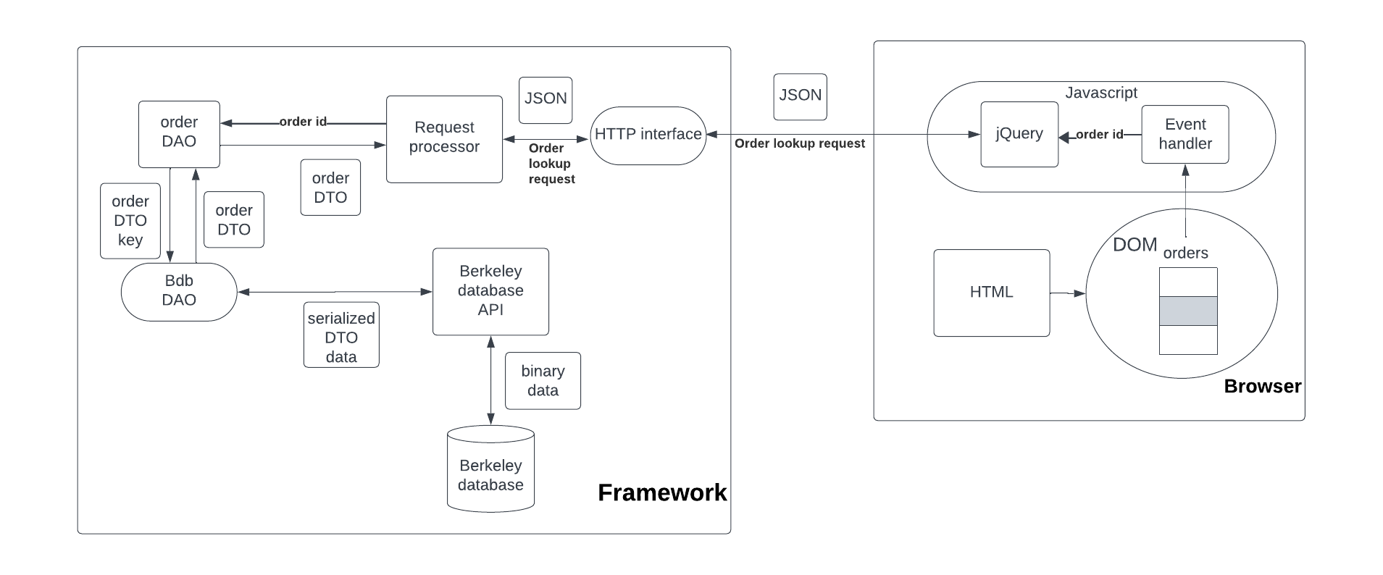
Sample application

Slide 13
Code walkthrough
Main program socket interface:
Bdb_inet_socket_server/Bdb_inet_socket_client
JSON Request handler: Dconf_request_handler
Order request handler: Dconf_order_request_handler
Order lookup: Order_DAO, Order_DTO
Database interface: Bdb_DAO
Berkeley DB access: Bdb_dbp, Bdb_dbt

Slide 14
Conclusions
The C++ Web Framework supports dynamic websites
Consists of a web server, application server, and browser
Developer tasks:
Design data interface
Define request processor
Write HTML, Javascript, jQuery for browser
Deploy web and application server to cloud environment
Framework supplies network/DB/data interfaces

